Slide 1

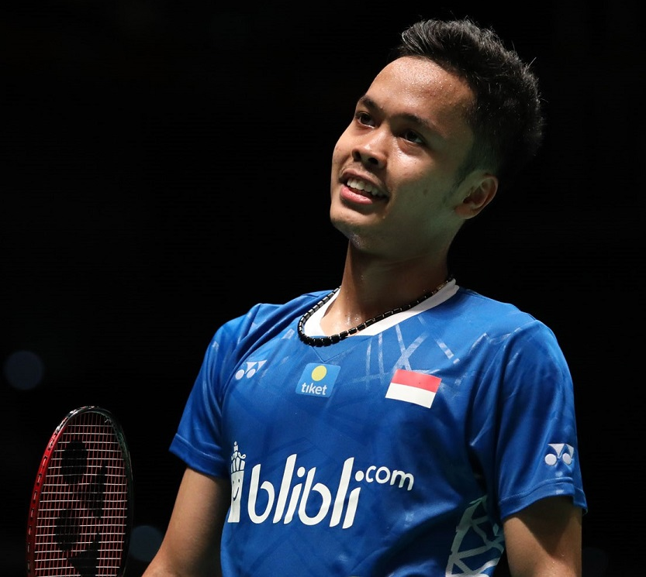





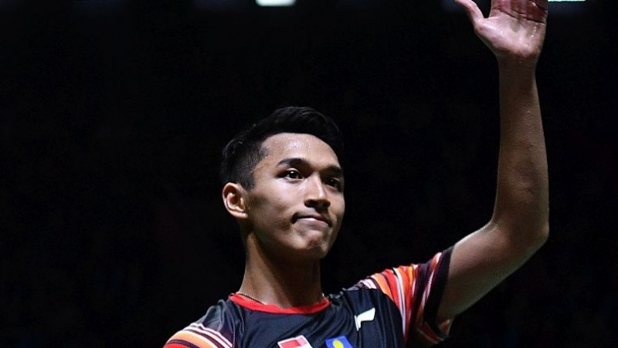
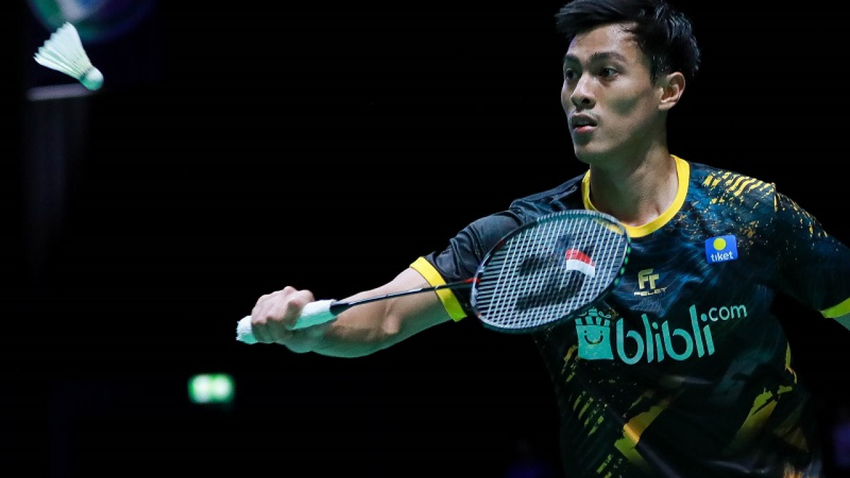
Indonesia’s Top 3
As of 17 March 2020
Men’s Singles
#1 Anthony Sinisuka GINTING
3
5-0
24
Fastest match (mins)
Best Head-to-Head
(bt. PARUPALLI Kashyap)
Highest Ranking
90
Longest match (mins)
Last Top Achievements
6
64
Win Rate (%)
Indonesia Masters 2020
RU BWF World Tour Final 2019
Current Ranking
52
Rally Domination (%)
China Open 2018
Indonesia Masters 2018
PBSI
#2 Jonatan CHRISTIE
4
26
5-0
Fastest match (mins)
Highest Ranking
82
Best Head-to-Head
(bt. Jan O JORGENSEN)
Longest match (mins)
66
Last Top Achievements
7
Win Rate (%)
BWF World Tour Final 2019 (Qual.)
52
Rally Domination (%)
Australia Open 2019
Current Ranking
New Zealand Open 2019
inews.id
#3 Shesar Hiren RHUSTAVITO
17
24
2-0
Fastest match (mins)
Highest Ranking
77
Best Head-to-Head
(bt. WONG Wing Ki Vincent &
KIDAMBI Srikanth)
Longest match (mins)
18
52
Win Rate (%)
50
Rally Domination (%)
Current Ranking
Breakingnews.co.id
Calculations only based on matches from BWF World Tour ≥ S300 Level and World Championships, starting from 2018 to All England 2020
Match Sources: bwfbadminton.com RU: Runner Up Qual.: Qualified Rally Domination: Total points won / total points, from all matches

Slide 2
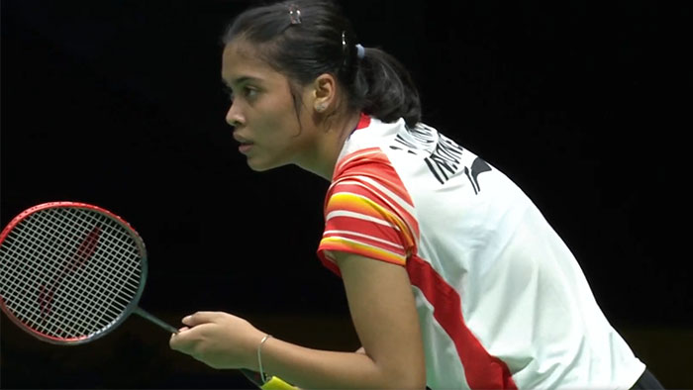


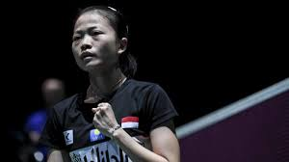

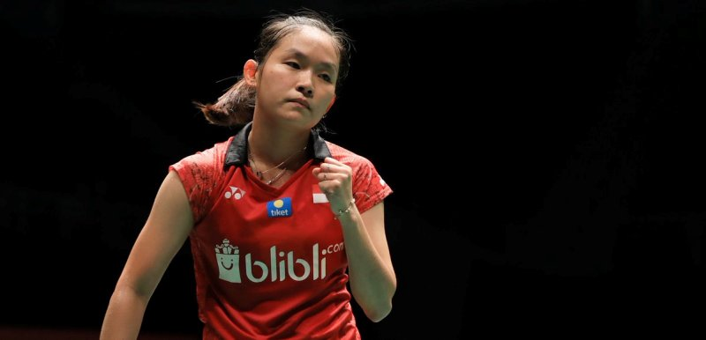
Indonesia’s Top 3
As of 17 March 2020
Women’s Singles
#1 Gregoria Mariska TUNJUNG
13
18
2-0
Fastest match (mins)
Best Head-to-Head
(bt. Busanan ONGBAMRUNGPHAN
& CHEN Xiao Xin)
Highest Ranking
68
Longest match (mins)
21
48
Win Rate (%)
51
Rally Domination (%)
Current Ranking
360badminton.com
#2 Fitriani
24
23
2-0
Fastest match (mins)
Best Head-to-Head
(bt. Busanan ONGBAMRUNGPHAN
& Kirsty GILMOUR)
Highest Ranking
74
Longest match (mins)
42
Last Top Achievements
33
Win Rate (%)
Thailand Masters 2019
48
Rally Domination (%)
Current Ranking
Kumparan
#3 Ruselli HARTAWAN
34
20
Fastest match (mins)
3-0
Highest Ranking
65
Best Head-to-Head
(bt. CHIANG Ying Li)
Longest match (mins)
35
49
Win Rate (%)
49
Rally Domination (%)
PBSI
Current Ranking
Calculations only based on matches from BWF World Tour ≥ S300 Level and World Championships, starting from 2018 to All England 2020
Match Sources: bwfbadminton.com RU: Runner Up Qual.: Qualified Rally Domination: Total points won / total points, from all matches

Slide 3
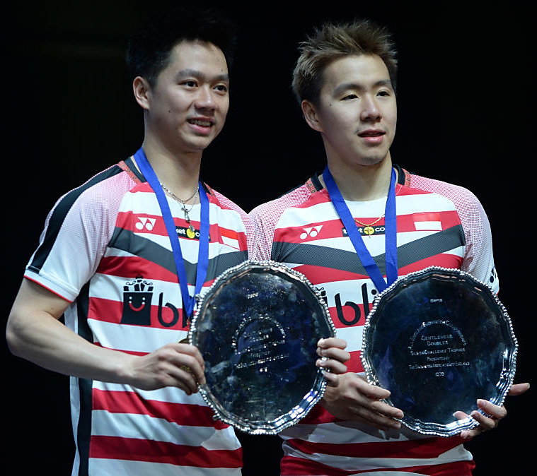




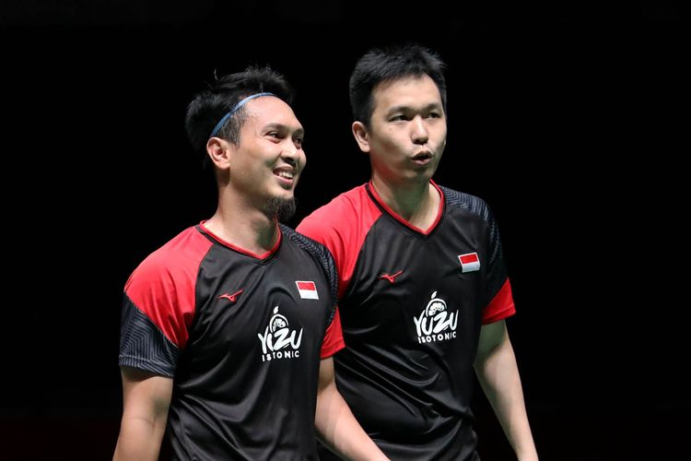
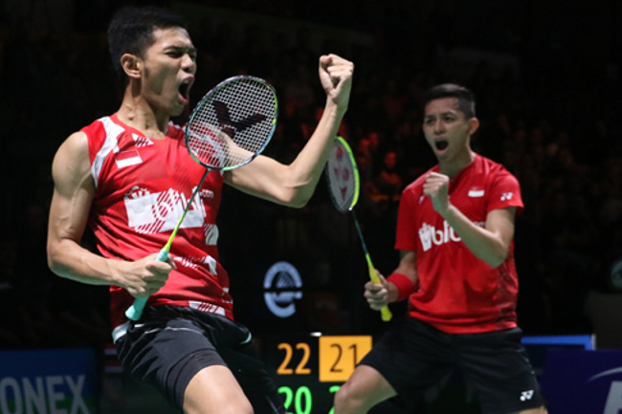
Indonesia’s Top 3
As of 17 March 2020
Men’s Doubles
#1 Marcus Fernaldi GIDEON/Kevin Sanjaya SUKAMULJO
1
23
10-0
Fastest match (mins)
Best Head-to-Head
(bt. Mohammad AHSAN/Hendra SETIAWAN)
Highest & Current
Ranking
72
Longest match (mins)
87
Last Top Achievements
Win Rate (%)
Indonesia Masters 2020
55
Rally Domination (%)
BWF World Tour Final 2019 (Qual.)
Fuzhou China Open 2019
French Open 2019
Fox Sport Asia
#2 Mohammad AHSAN/Hendra SETIAWAN
2
20
6-2
Fastest match (mins)
Best Head-to-Head
(bt. Hiroyuki ENDO/Yuta WATANABE
& LEE Yang/WANG Chi-Lin)
Highest & Current
Ranking
67
Longest match (mins)
74
Last Top Achievements
Win Rate (%)
BWF World Tour Final 2019
52
Rally Domination (%)
World Championships 2019
All England Open 2019
`Badminton Indonesia
#3 Fajar ALFIAN/Muhammad Rian ARDIANTO
5
21
3-0
Fastest match (mins)
Best Head-to-Head
(bt. LEE Yang/WANG Chi-Lin
& GOH V Shem/TAN Wee Kiong)
Highest Ranking
71
Longest match (mins)
70
Last Top Achievements
6
Win Rate (%)
Korea Open 2019
52
Rally Domination (%)
Swiss Open 2019
Current Ranking
Syed Modi Championships 2018
PBSI
Calculations only based on matches from BWF World Tour ≥ S300 Level and World Championships, starting from 2018 to All England 2020
Match Sources: bwfbadminton.com RU: Runner Up Qual.: Qualified Rally Domination: Total points won / total points, from all matches

Slide 4
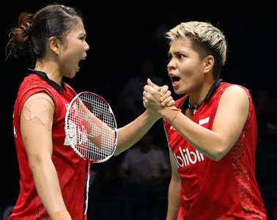




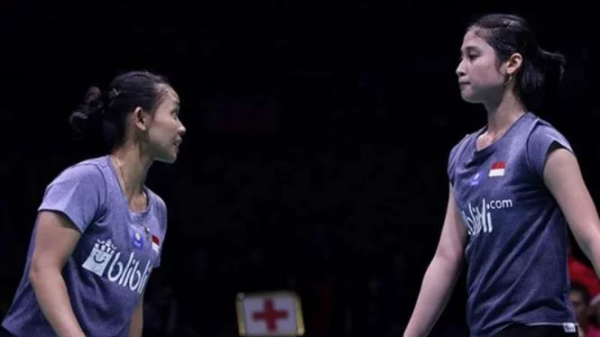
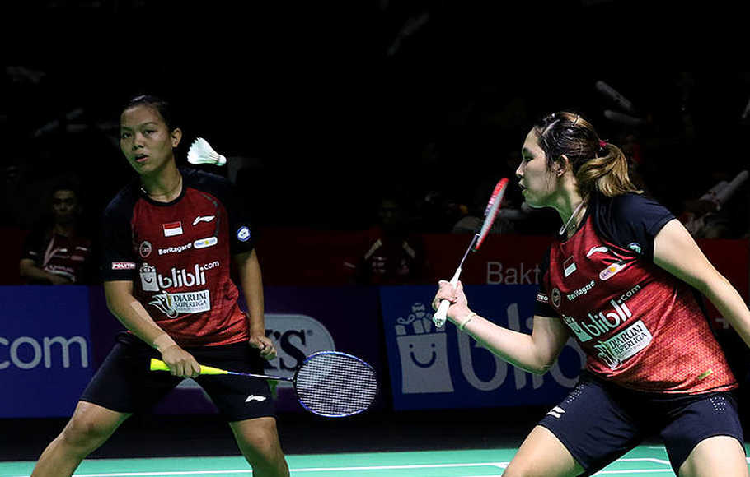
Indonesia’s Top 3
As of 17 March 2020
Women’s Doubles
#1 Greysia POLII/Apriyani RAHAYU
3
21
4-0
Fastest match (mins)
Highest Ranking
105
Best Head-to-Head
(bt. HSU Ya Ching/HU Ling Fang
& Maiken FRUERGAARD/Sara THYGESEN)
Longest match (mins)
8
71
Win Rate (%)
Last Top Achievements
53
Barcelona Spain Master 2020
Current Ranking
Rally Domination (%)
Indonesia Masters 2020
BWF World Tour Final 2019 (Qual.)
Antara
India Open 2019
#2 Della Destiara HARIS/Rizki Amelia PRADIPTA
9
20
1-0
Fastest match (mins)
Highest Ranking
84
Best Head-to-Head
(bt. Debora JILLE/Imke VAN DER AAR
& Anastasiia AKCHURINA/Olga MOROZOVA)
Longest match (mins)
19
51
Win Rate (%)
51
Rally Domination (%)
Current Ranking
PBSI
#3 Siti Fadia Silva RAMADHANTI/Ribka SUGIARTO
32
21
2-0
Fastest match (mins)
Highest & Current
Ranking
62
Best Head-to-Head
(bt. Pooja DANDU/SANJANA SANTOSH
& CHANG Ching Hui/YANG Ching Tun)
Longest match (mins)
56
Win Rate (%)
51
Rally Domination (%)
Djarum Badminton
Calculations only based on matches from BWF World Tour ≥ S300 Level and World Championships, starting from 2018 to All England 2020
Match Sources: bwfbadminton.com RU: Runner Up Qual.: Qualified Rally Domination: Total points won / total points, from all matches

Slide 5
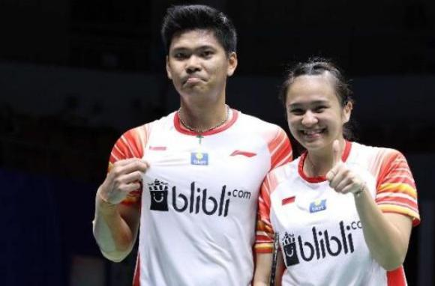




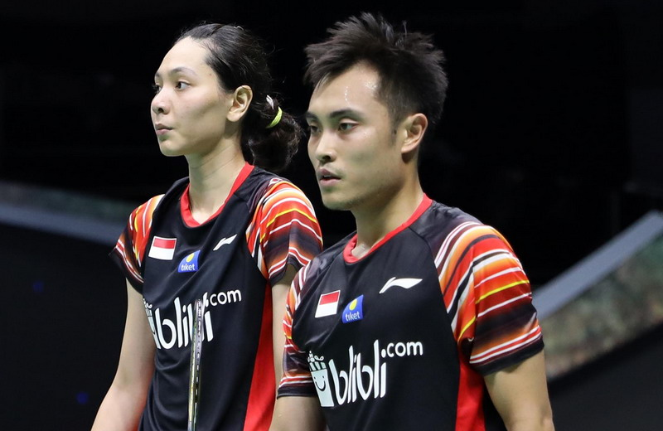




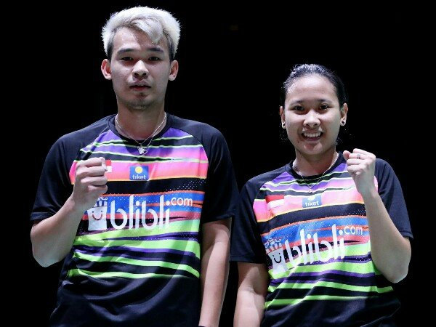
Indonesia’s Top 3
As of 17 March 2020
Mixed Doubles
#1 Praveen JORDAN/Melati Daeva OKTAVIANTI
4
20
4-0
Fastest match (mins)
Best Head-to-Head
(bt. WANG Chi-Lin/CHENG Chi Ya)
Highest & Current
Ranking
84
Longest match (mins)
65
Last Top Achievements
Win Rate (%)
All England Open 2020
52
Rally Domination (%)
BWF World Tour Final 2019 (Qual.)
French Open 2019
PBSI
Denmark Open 2019
#2 Hafiz FAIZAL/Gloria Emanuelle WIDJAJA
6
21
2-0
Fastest match (mins)
Highest Ranking
71
Best Head-to-Head
(bt. LU Kai/CHEN Lu
& Rinov RIVALDY/Pitha Haningtyas MENTARI)
Longest match (mins)
8
60
Win Rate (%)
Last Top Achievements
52
BWF World Tour Final 2019 (Qual.)
Current Ranking
Rally Domination (%)
Thailand Open 2018
PBSI
#3 Rinov RIVALDY/Pitha Haningtyas MENTARI
16
21
1-0
Fastest match (mins)
Highest Ranking
73
Best Head-to-Head
(bt. Marvin SEIDEL/Linda EFLER
& Nyl YAKURA/Kristen TSAI)
Longest match (mins)
18
52
Win Rate (%)
50
Rally Domination (%)
Current Ranking
PBSI
Calculations only based on matches from BWF World Tour ≥ S300 Level and World Championships, starting from 2018 to All England 2020
Match Sources: bwfbadminton.com RU: Runner Up Qual.: Qualified Rally Domination: Total points won / total points, from all matches

